Slide 1
The Beaney – Visual Story
This is a guide for getting into and around The Beaney Museum in Canterbury. It also helps visitors know more about the inside of the museum and gallery before visiting.
Getting here: Orange Street accessible car park is behind the museum and has 14 Blue Badge spaces. Parking is free for 4 hours.
The bigger, St Radigans carpark is a 6 minute walk away post code: CT1 2AE
The main bus station is a 10 minute walk away from the top of the High Street, behind the White Friars Shopping Centre.
The nearest train station is Canterbury West, which is a 10 minute walk away

Slide 2
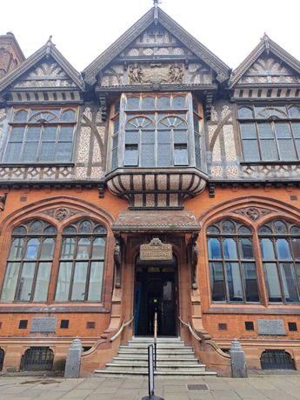
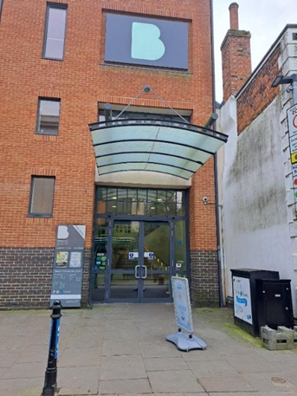
The museum has two entrances, the old front door is on The High Street in Canterbury and the new accessible entrance is on Best Lane, which is around the corner.
The old Front Door
The accessible entrance

Slide 3
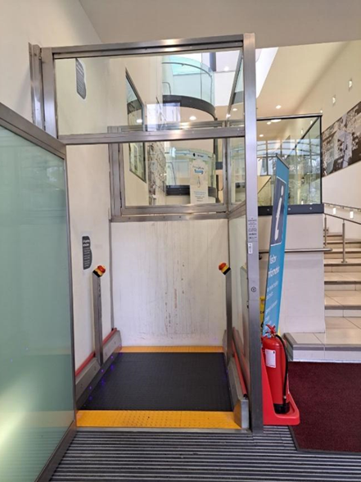
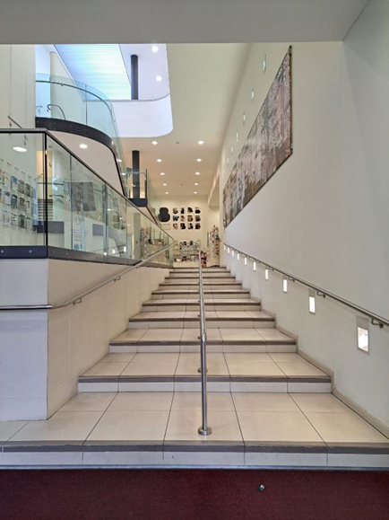
The accessible entrance has automatic doors.
Inside there are 10 long ‘easy going’ steps going up to
the Visitor Information Desk
There is also a lift on your left to use instead of the stairs

Slide 4
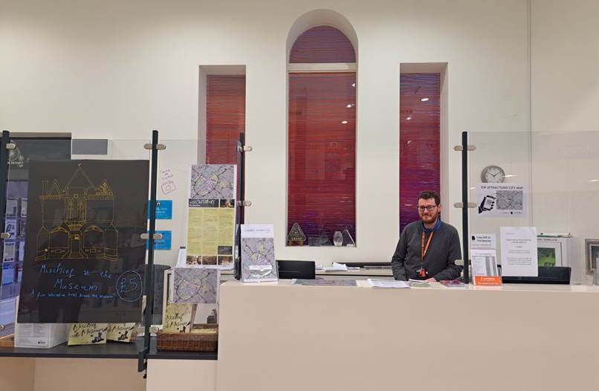
Go up the stairs or in the lift up to the next level. On the left is the Library which is not part of the Museum but you can go in there if you like.
On the right is the Visitor Information Desk. It always has a member of staff working here, they wear orange lanyards and offer help. The museum is free to visit, but tickets to special exhibitions can be bought from here. You can also get trails for children here and borrow a sensory backpack.

Slide 5
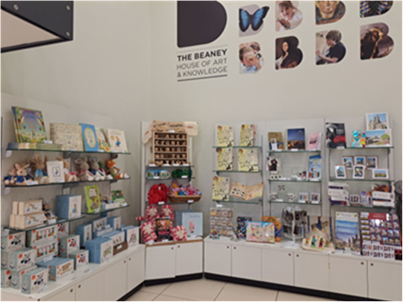
There is a small shop nearby and you pay for the things at the reception desk.

Slide 6
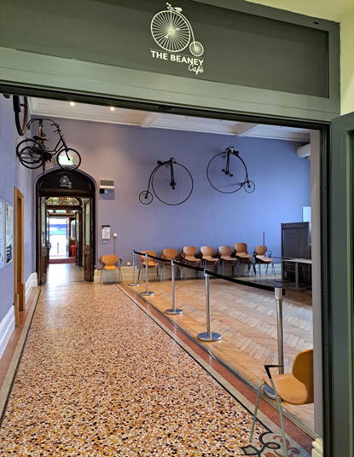
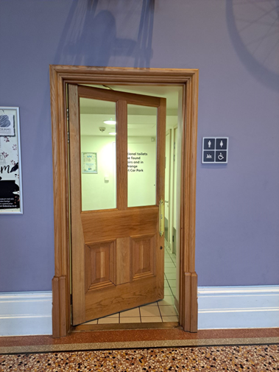
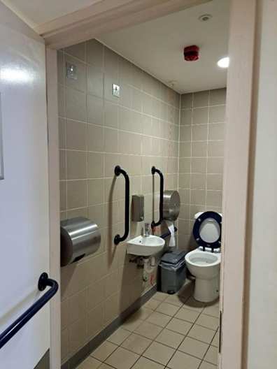
Through the door on the right is The Café (which is currently closed) it has old bicycles on the wall!
The entrance to the public toilets are also here. There are two toilets, both can be used by men or women and one is a disabled access toilet. The other one has a baby change bed in it.

Slide 7
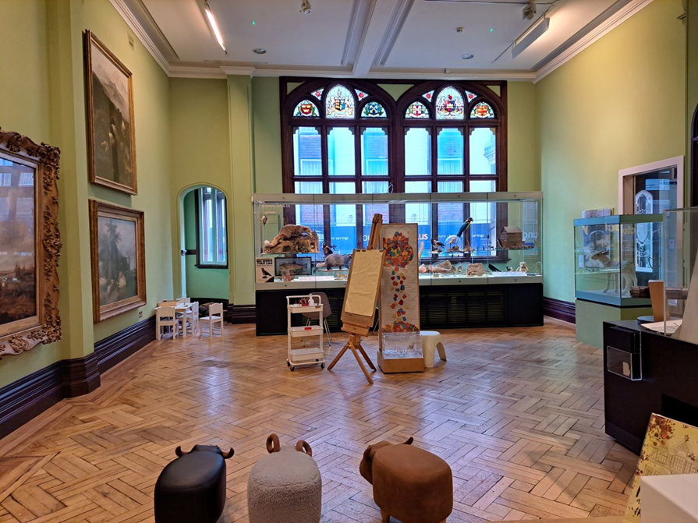
Now leave the café through the next doorway, you will see a big staircase on your right.
On your left is a gallery called The Garden Room. This room has paintings and objects about animals in it.
There is also a small shop and desk in this room, where a member of staff sits. You can ask them questions about the museum.

Slide 8
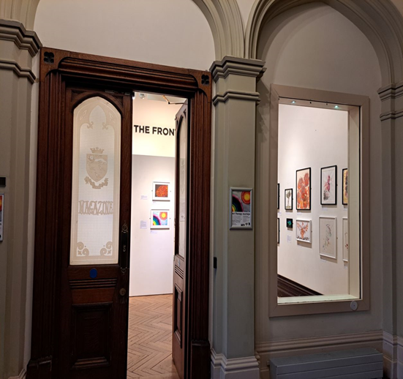
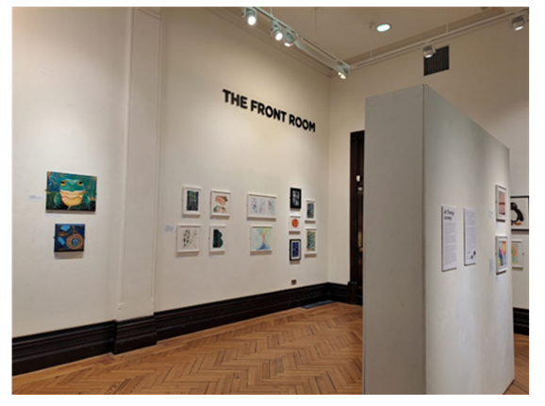
Leave the gallery by the other door. Straight ahead of you is The Front Room, this is a temporary exhibition space.
This room sometimes has things in it made by the local community of Canterbury. The room layout changes often and it looks different each time the topic changes, with different paintings and objects displayed.
There may be screens with film and audio sometimes, but usually earphones are used to listen to the sound.

Slide 9
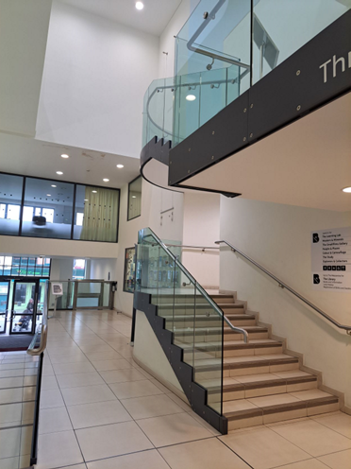
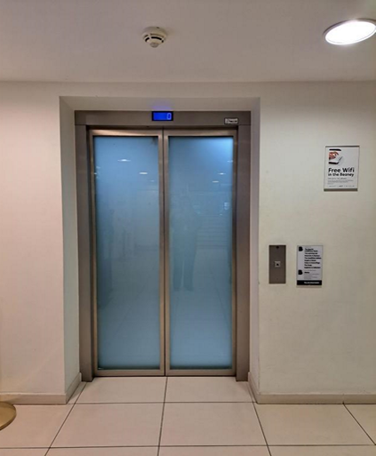
Now leave the Front Room and turn left. Go back the way you came, through the café back to the front desk.
You will see stairs on your left and a lift on your right. You can go upstairs in the lift or climb the stairs. If using the lift, press the 1 button.

Slide 10
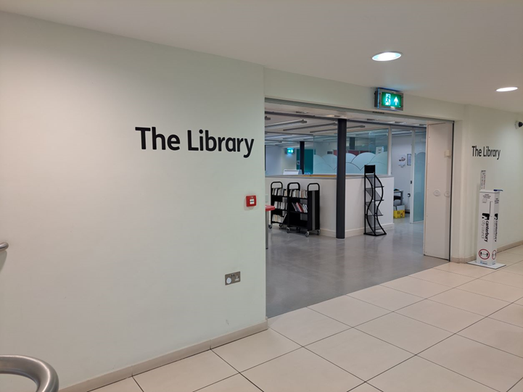
If you take the stairs, you will come to a mezzanine level first – this goes into the library. Ignore it and keep going upstairs to the first floor.

Slide 11
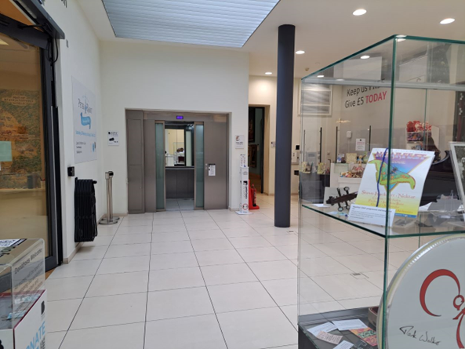
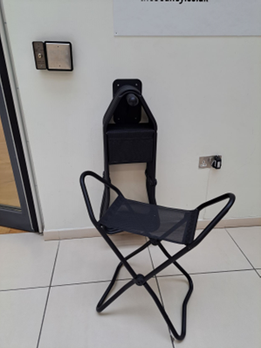
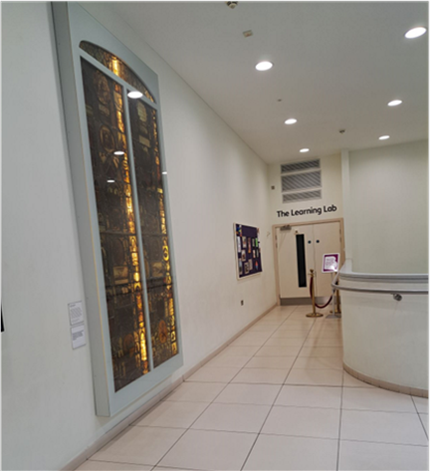
The first floor in The Beaney is also called The Atrium, it has another small shop with a member of staff sitting at a desk. There is a small display case that has changing temporary exhibitions in it. There are also folding stools that you can borrow and take with you around the museum to sit on.
In this space there are many doorways, one to the Special Exhibition Room, one to The People and Places Gallery and one to the Materials and Masters Gallery.
The entrance to the Learning Lab is also from the Atrium space, this is only open to school groups and used for workshops.

Slide 12
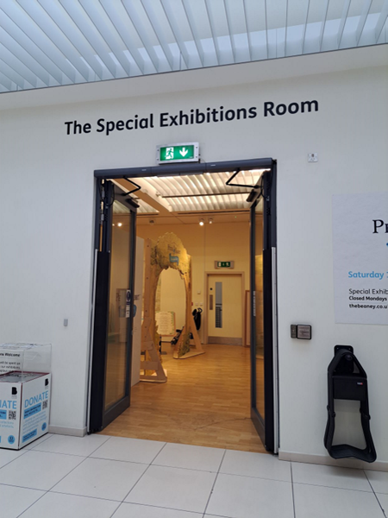
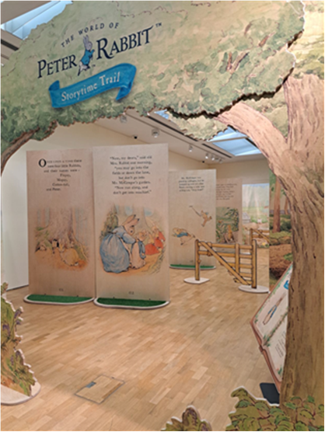
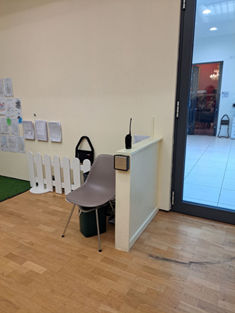
The Special Exhibition Room has glass doors that open by pressing the large metal button on the wall. If a member of staff is inside near the door, they can open it for you.
This is a large room that looks different each time there is a new exhibition in it. The walls might be in a different place and the room colour may change. There will always be a member of staff in here as you enter the room.
Sometimes there is a children’s activity area in this room. The exhibitions in this room change every few months to different topics.

Slide 13
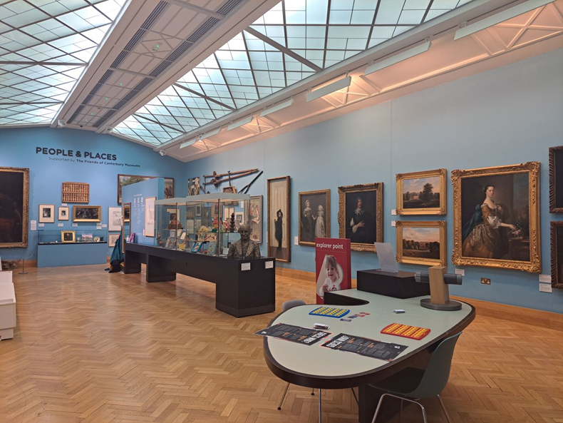
Now leave the Special Exhibition room. You can choose where to go next but for this route, turn left and go through the doorway into the blue gallery which is called The People and Places Room.
In this room there are paintings of places and people and some big sculptures of people too.
There is also a sculpture of the Red Dean which you can touch if you borrow gloves from the staff in the Atrium shop.
There is a large mirror with dressing up clothes and an activity table with games on.
There is a Rupert the Bear display case in the middle of the room.
There are benches for sitting on in this room.

Slide 14
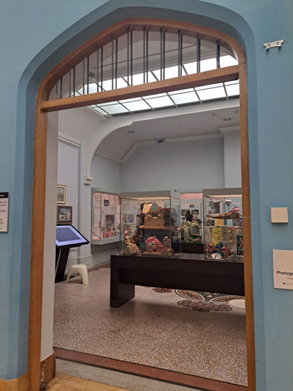
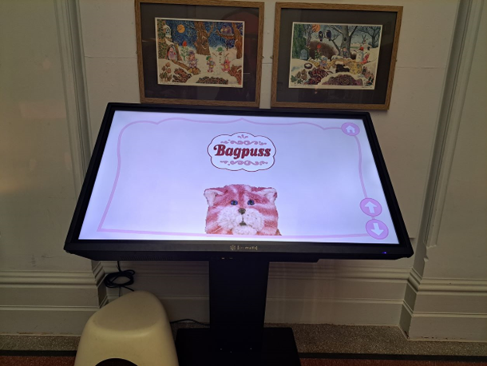
Now go through an archway into the Smallfilms Gallery. This is named after the film company Smallfilms who made children’s television programmes like Bagpuss. You can see the real puppets they used.
There is also a large screen which is interactive. You can touch it to choose pictures and sounds, which it plays out loud.

Slide 15
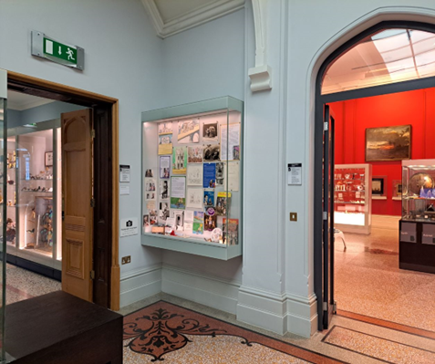
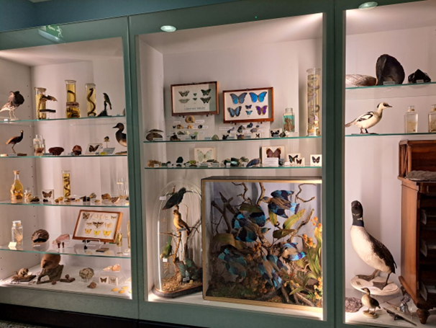
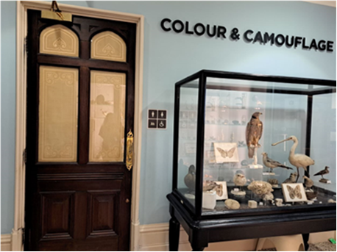
From this room go through the doorway on the left into the Colour and Camouflage Gallery.
The Colour and Camouflage gallery has natural history objects displayed by their colour.
There is also a door here leading to two public toilets.

Slide 16
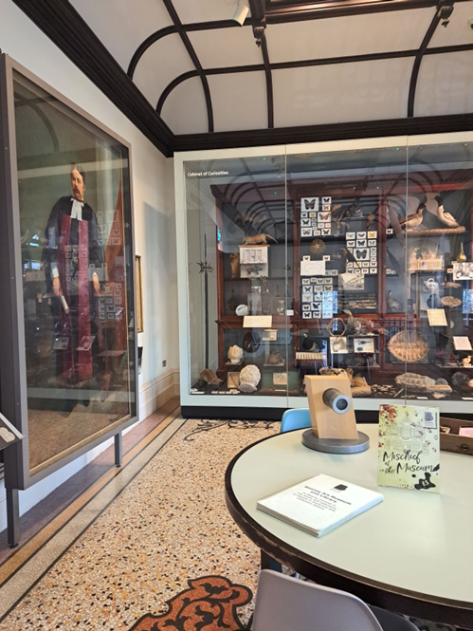
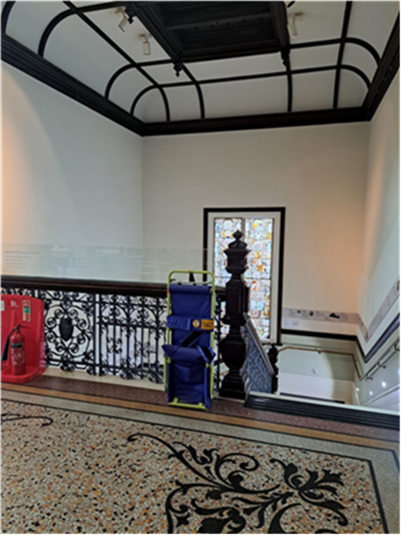
Leave this gallery and go straight ahead into The Study
This Gallery is about Dr James Beaney who donated money to Canterbury to build this museum was a collector from Canterbury, this Museum is named after him.
A painting of him and a large display case of natural history objects are in this room.
There is also an activity table and some chairs here.
The top of the old staircase leads from this room and goes back down to the Garden Room.

Slide 17
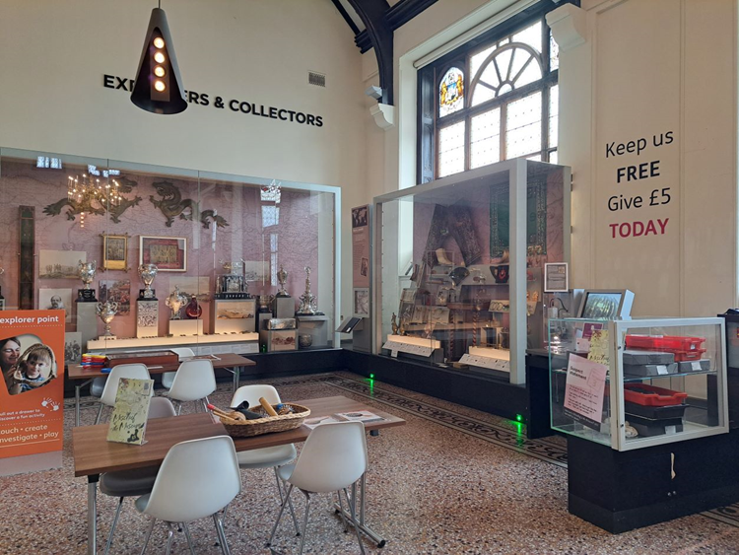
Now go straight ahead into the Explorers and Collectors Gallery
This is a large space and can be very noisy. The ceiling is high and the windows are open sometimes, so you can hear sound from the high street outside.
This gallery has lots of different objects from around the world and from different times.
This gallery always has a member of staff in it and there are activities on the tables they can help you with.

Slide 18
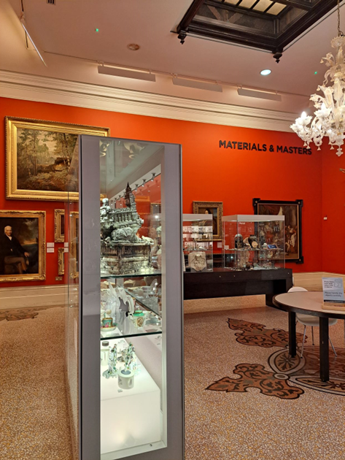
Now go back the way you came until you are in the Small Films gallery. Turn left into a red room. This is the Materials and Masters gallery.
In the Materials and Masters Gallery there are paintings on the walls and lots of objects in large glass cases. The objects are displayed by what they are made from, their materials.

Slide 19
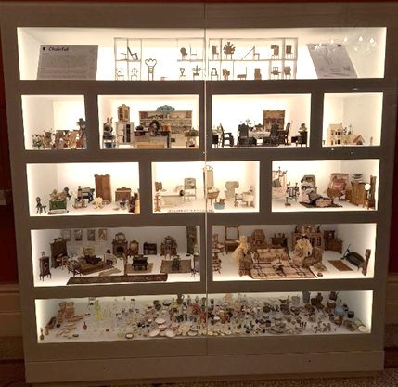
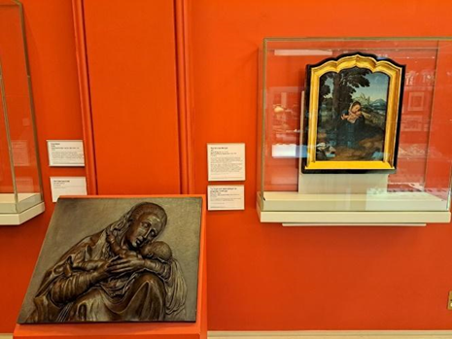
There is also a large dolls house which is lit up so you can see the tiny objects in it.
There is a bronze relief sculpture that you can touch which is a copy of the Virgin Mary and Child in the painting next to it.

Slide 20
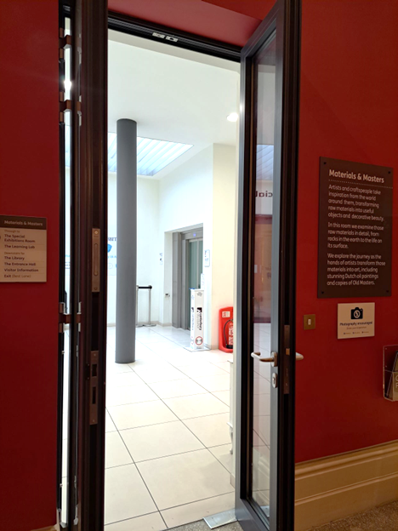
From this gallery you can leave through the doorway back into The Atrium and either go down the stairs or use the lift back down to the ground floor.
When you are finished, you can leave by the front door onto the High Street or through the Accessible entrance onto Best Lane.
We hope you enjoyed your visit to The Beaney Museum today.
You can find out about our temporary exhibitions and events on our website:
www. canterburymuseums.co.uk/the-beaney/
We are also on Facebook as The Beaney
We are also on Twitter and Instagram as @The Beaney

